Slide 1
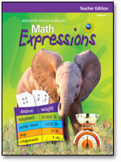
3rd Grade Unit 2 Geometry
MATH EXPRESSIONS
Created By: Mrs. Leanna Hopkins

Slide 2
Do you remember?
Line segment
Endpoint
Line
Horizontal
Vertical
Parallel
Perpendicular
Triangle
Quadrilateral
Opposite
Adjacent
Parallelogram
Rhombus
Rectangle
Square
Perimeter
Centimeter

Slide 3
Line segment
A part of a line; A line segment has two endpoints

Slide 4
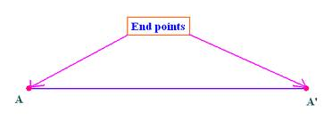
Endpoint
The point at either end of a line segment

Slide 5
Line
A straight path that goes on forever in opposite directions
What are some types of lines?
Horizontal
Vertical
Parallel
Perpindicular

Slide 6
Horizontal lines
Lines that extend in two directions, left and right.
What is the opposite of horizontal?
Vertical

Slide 7
Vertical lines
Lines that extend in two directions, up and down

Slide 8
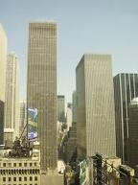
Parallel lines
Two lines that are the same distance apart everywhere
What is the opposite of parallel?
Perpendicular

Slide 9
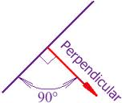
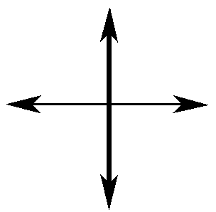
Perpendicular lines
Two lines that cross to form right angles

Slide 10
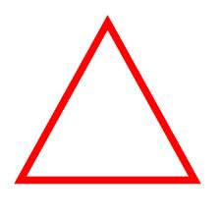
Triangle
A polygon with three sides
What is a polygon with four sides called?
A quadrilateral

Slide 11
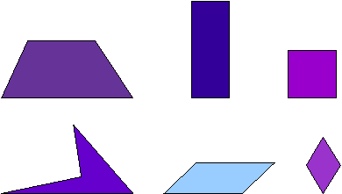
Quadrilateral
A polygon with 4 sides
What are some types of quadrilaterals?
Parallelograms Trapezoids Squares Rectangles Rhombuses

Slide 12
Opposite sides
Sides that are across from each other; they do not meet at a point
Example:
Sides A and B are opposite of each other
Would sides A and D be opposite of each other?
No
What would sides A and D be?
Adjacent to each other
A
C
D
B

Slide 13
Adjacent sides
Two sides that meet at a point
Example:
Sides A and D are adjacent to each other
Are sides A and B opposite or adjacent?
Opposite
A
C
D
B

Slide 14
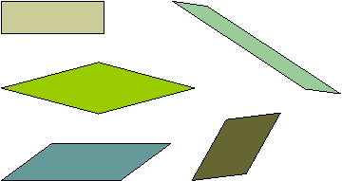
Parallelogram
A quadrilateral with both pairs of opposite sides parallel
What are some examples of parallelograms?
Rhombus Square Rectangle

Slide 15
Rhombus
A parallelogram with congruent sides

Slide 16
Rectangle
A parallelogram that has all right angles

Slide 17
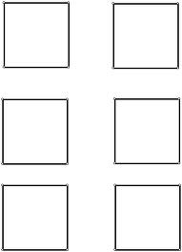
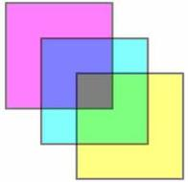
Square
A parallelogram with 4 congruent sides and 4 right angles
A square is both a rhombus and a rectangle

Slide 18
Perimeter
The distance around the outside of a figure
2
1+2+1+2 = 6
6 is the perimeter of the figure
1
1
2

Slide 19
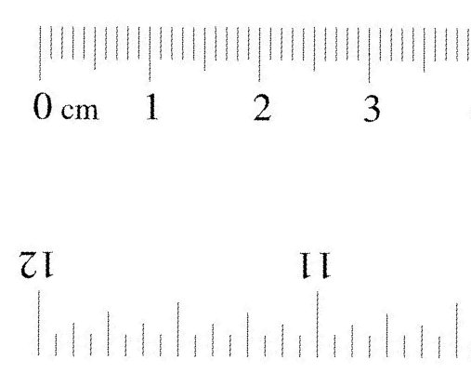
Centimeter
A metric unit of measurement used to measure length

Slide 20
Line or line segment ?

Slide 21
Horizontal or Vertical?

Slide 22
Parallel or perpendicular?

Slide 23
Triangle or quadrilateral ?

Slide 24
Rhombus or rectangle?

Slide 25
What is the perimeter?
1
1
3

Slide 26
Good luck on the test (:

